Slide 1
Two Force Members
Dr. Jacob Moore
Associate Professor of Engineering
Penn State Mont Alto

Slide 2
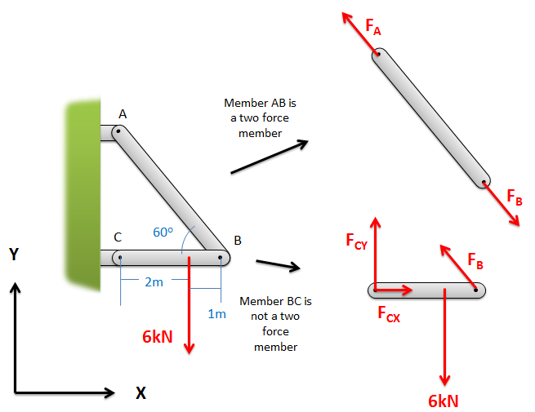
Two Force Members
A two-force member is a body that has forces (no moments) exerted at only two points.
These can be directly applied forces or reaction forces.

Slide 3
Two Force Members
A two-force member will have two equal, opposite, and collinear forces acting on it.
Remember that if a structure is in equilibrium, each member is in equilibrium
Tension
Compression

Slide 4
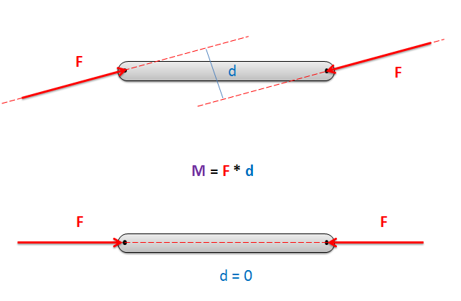
Two Force Members
Why equal, opposite, and collinear?
The forces (or sum of the forces) acting on each end are equal and opposite because the sum of the forces must be zero.
The forces (or sum of the forces) acting on each end are collinear because the sum of the moments must be zero.

Slide 5
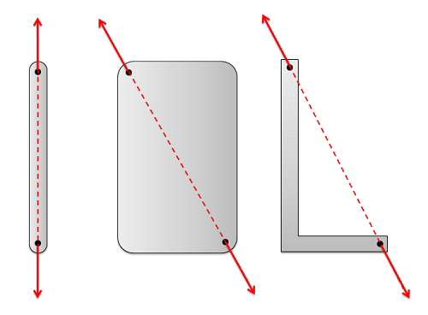
Two Force Members
The line of action of the two forces will always be the line directly between the two connection points.
The shape or size of the member does not affect the direction of the forces.

Slide 6
Why are Two Force Members Important?
The method of joints and the method of sections (used with trusses) assumes that we have equal and opposite forces on a known direction (like forces in two force members).
This lets us take shortcuts in the analysis
The method used to analyze frames and machines does not rely on the assumption that forces are equal, opposite, and have a known direction.
This type of analysis is a little more time consuming than the methods used for trusses
Either way, identifying a two-force member will reduce the number of unknown forces we have to solve for.
Each two-force member will only have one unknown to solve for, whereas non-two force members can have many unknowns to solve for

Slide 7
Thanks for Watching
See other engineering mechanics videos and access the full tool at…

